Slide 1
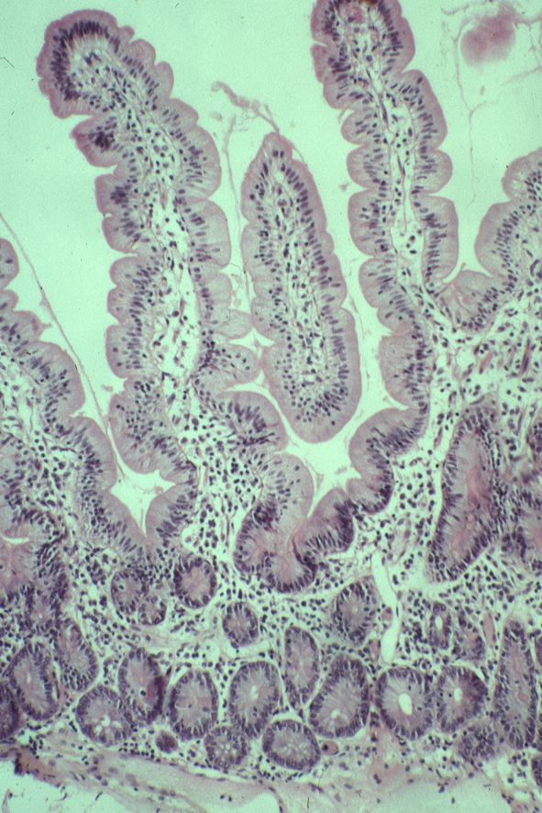
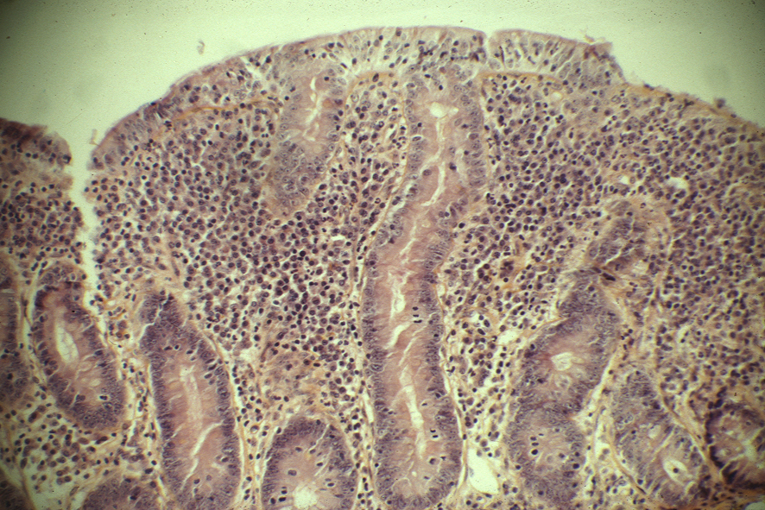
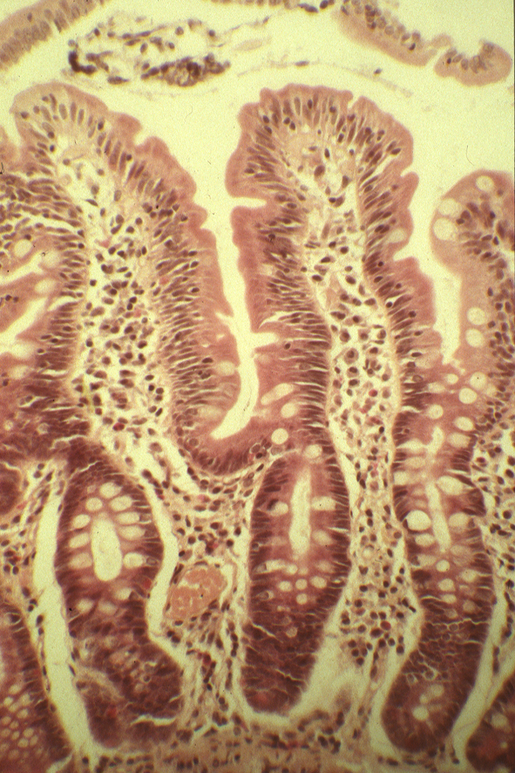
Celiac Disease:
T cell-mediated enteropathy
Normal
Active celiac
Gluten Free Diet
Small intestine biopsies
ANTIGEN: Gluten
HLA association: HLA-DQ2 and HLA-DQ8 molecules (accounts for 40% of the genetic risk)
Notes:
We have access to tissue samples
Tissue stress

Slide 2
Intraepithelial lymphocyte infiltration
is a hallmark of celiac disease
Notes:
CD is a common inflammatory bowel disease induced by gluten a protein present in wheat.
It’s characterized by villus atrophy and destruction of the surface intestinal epithelium. Most of the time a GFD cures the patient who reacquire a quasi normal intestinal morphology with long villi and short crypt.
As shown on this CD3 staining, the number of lymphocytes within the epithelium (IEL) is dramatically increased in active celiac disease. This increase is a hallmark of celiac disease. It is also the earliest morphological change correlating with the villus atrophy
Moreover, in some case IEL undergo malignant transformation suggesting that these cells are chronically activated.
Surprisingly, T cells specific for peptides from gluten has been found in the lamina propria but not in the epithelium.
Until know, there is no evidence for a TCR dependent activation by gluten in celiac IEL

Slide 3
Sorting Strategy
1
2
3
4
5
DN

Slide 4
TCR ɣδ IEL Increase in Disease

Slide 5
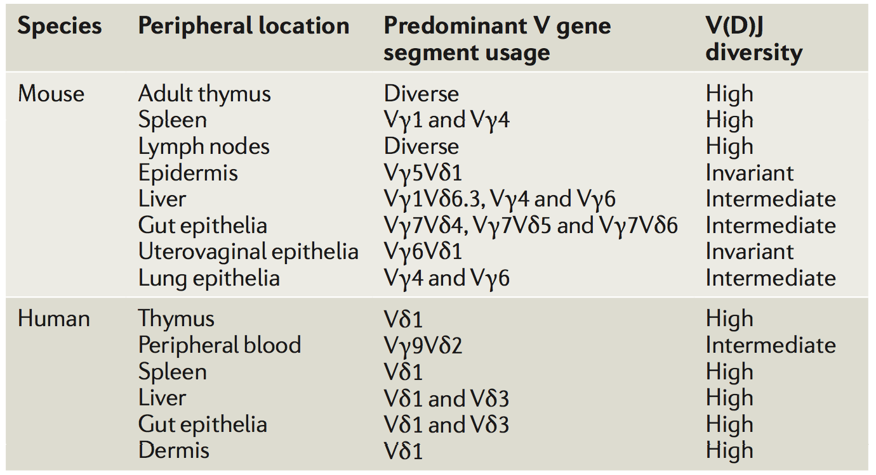
TCR Chain Distribution
Bonneville, M et al. Nature Rev. Imm. 2010.

Slide 6
Ligands
Vantourout P and Hayday A. Nature Reviews Immunology. 2013
Born K, et al. Cellular & Molecular Immunology

Slide 7
Objectives
Investigating the repertoire of both ɣ and δ chains in peripheral blood lymphocytes (PBL) and intestinal epithelial lymphocytes (IEL).
Investigating the impact of CD disease state on the repertoire of both ɣ and δ chains in IEL.

Slide 8
V(D)J Recombination
Janeways’s Immunobiology 8th Edition
Notes:
8 delta in humans
6 gamma

Slide 9
Template-Switch Anchored RT-PCR
Moloney Murine Leukemia Virus (MMLV) reverse transcriptase
In collaboration with David Price
Notes:
You get rid of primer bias because everybody gets the same set of primers

Slide 10
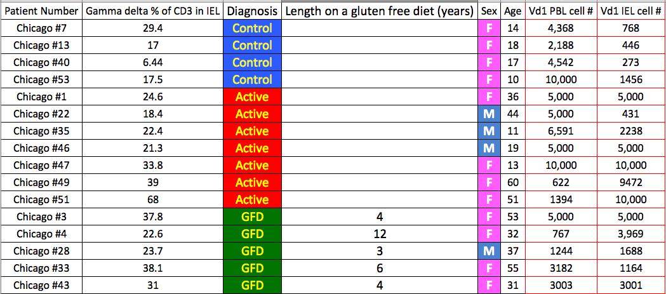
Sample Breakdown

Slide 11
Semi-Analyzed Data

Slide 12
What we would like to model
ɣ and δ usage in IEL and/vs. PBL
ɣ and δ diversity in IEL and/vs. PBL
CDR3 length dynamics between ɣ and δ chains across IEL and PBL
Motif usage/conservation in IEL vs. PBL
All of the above in health vs. disease
Can we incorporate all the above into a dynamic system that can model the transition from health to disease and back to health again

